Slide 1
Anti-Racist Pedagogy Series: Anti-Racist Course Facilitation
Faculty Center for Ignatian Pedagogy

Slide 2
Acknowledgements
The Loyola community occupies the traditional homelands of the people of the Council of Three Fires, the Ojibwe, Potawatomi, and Odawa as well as the Menominee, Miami and Ho-Chunk nations. This was also a site of trade, travel, gathering and healing for more than a dozen other Native tribes and is still home to over 100,000 tribal members in the state of Illinois.
Thank you to our faculty contributors:
Sasha Adkins
Susan Haarman
Betsy Jones Hemenway
Kristin Krueger
Thea Strand
Aana Vigen

Slide 3
Session Agenda
Laying the groundwork for our discussion
Discussing how to infuse anti-racist pedagogy into these relationships
Student-faculty
Student-student
Student-content
Using the chat feature to engage in dialog
The session is being recorded and all of the materials will be shared on FCIP's website

Slide 4
Invitation for Reflection
Beginning from a place of Ignatian Indifference...
Regarding things only insofar as they bring you closer to God or the Common Good.
In other words, it’s the capacity to move away from what does not help me to work for justice or love others or connect to God—while staying engaged with what does.
What about my discipline, my research, my pedagogy, or my typical reactions might be something I should "regard with indifference" as I think about Anti-Racist course design?

Slide 5
"Racist" or "Anti-Racist"
is what we do, not who we are.
(a paraphrase of Ibram X. Kendi)
Notes:
(Sasha's slide) The usual way to think about racism is that there are prejudices-- some kind of negative feelings or negative assumptions that we have about another group. And that if we are the group of people in power, we can institutionalize those prejudices and then our cultural and political systems give preference to our group over another, making those of us in power feel superior and the people being discriminated against believe that it is their own fault for their innate inferiority. So this way of looking at racism makes those of us who are White bad. Even if you aren't aware that you have these negative feelings and assumptions, they are lurking inside you and they are called implicit bias and you are bad anyway, no matter how hard you try not to feel those things. No wonder conversations about race make White people uncomfortable. It might feel like the only way out of this mess is self-flagellation. Then Ibram X Kende came along and reframed it, in his book How To Be an Anti-Racist. He posits that being racist or anti-racist isn't something you are, it's something you do. You look at how your actions are impacting other groups and if it is creating more opportunities for everyone to thrive then it is anti-racist. I like this because you have this opportunity with every action to chose to contribute to the greater good. Putting the focus on impacts not intentions means that when we say Why are police 3.5 times more likely to kill Black men than White men, the conversation can be about saving lives, not about whether or not some individual police officer meant to be discriminatory or not. When we say that 70% of COVID-19 deaths in Chicago are Black and Brown folks, we can talk about saving lives and not get sidetracked into arguing whether these folks are impacted more because they are poor or because they are racialized. Because this conversation really is about life and death.

Slide 6
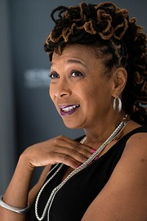
Intersectionality
Kimberlé Crenshaw
Notes:
(Sasha's slide) Kimberle Crenshaw invites us to think about intersectionality-- that being a single parent living in poverty is hard, and it is even harder if you live with a disability, and that is even harder if you are Black in this country, or indigenous, or undocumented. The idea that groups have power over others.

Slide 7
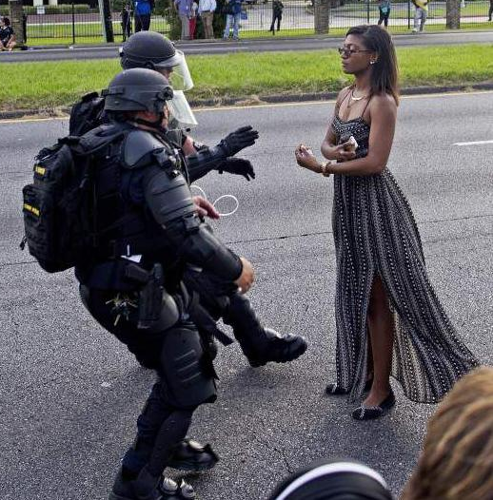
power
power
within
over
with
Which do we model in our classrooms?
Notes:
(Sasha's slide) This is Ieshia Evans, in Baton Rouge, in 2016.
Last summer I was at a conference and we were having a session on the Anthropocene, our current geological age, and we were asked how we would define it. The consensus was that it meant The Age of Man, and the particpants were in agreement that it meant that the problem was men. I don't agree with that and so I suggested instead that the problem is that we are in the Age of Power Over. We have an idea that what we really need is scarce and that we have to compete for it and this mentality is so ingrained in us that questioning it feels like questioning whether gravity exists. We think we have to enFORCE domination over nature, and over other people, or we won't get our needs met. There is always this fear and that is what motivates us. Well, my particular form of activism in the world is prefigurative politics, and so I use the classroom as an opportunity to create an experience of what another world might look like. I'm a big fan of the Chronicles of Narnia, so if you are familiar with that story, there is Turkish delight candy that is enchanted so that once you've tasted it, you want more and more of it. My job is to create that insatiable hunger for justice in my students. Spring semester when we were doing our closing circle, on Zoom, on the last day of class, one student said that she had never felt so respected as she did in our class. I think she was crying when she said it because she worried that she wouldn't ever have that experience again, but now her job is to go out and CREATE spaces where respect is the norm. Our job is to show each other by HOW we conduct class, no matter what the content, what it looks like to hold space where everyone's needs are met. By that I mean our deepest needs, for respect, for compassion, for courage because these things are the opposite of scarce. The more we draw them out of each other, the more there is to go around. That is the essence of power with, helping each other find our power within. The idea that I am stronger when you are strong. I want to invite us to examine how our practices and our presence in the classroom either reinforce notions of hierarchy and coercive control, or whether we are embodying servant-leadership, bringing out the best in each other. The real lesson that students remember for the rest of their lives is this invisible curriculum. That's how I conceptualize an anti-racist liberatory classroom.

Slide 8
This process itself becomes a detour when we focus more on saying the right words than on addressing the root causes of injustice.
Notes:
(Sasha's slide)

Slide 9
Today's Topic: Class Facilitation
Focus on establishing and sustaining relationships in the classroom and beyond
Sites for relationship work
Student-faculty
Student-student
Student-content
Notes:
Thea

Slide 10
Student-Faculty Relationships & Interactions
Thea Strand, PhD, Anthropology
Susan Haarman, MDiv, Center for Experiential Learning
Kristin Krueger, PhD, Anthropology
Aana Vigen, PhD, Theology
Notes:
Thea can introduce

Slide 11
Day 1: Meeting & Addressing Students
First meeting
Calling roll
Self-introduction
Power and identity in personal address and reference
Names
Pronouns
Notes:
Thea

Slide 12
Names as Proxy for Race & Ethnicity
White, Anglo privilege in "easy," "normal," "American" names
Experiences of disempowerment, frustration, and shame for those with minoritized names
Notes:
Thea

Slide 13
Showing Respect & Taking Responsibility
Don't call attention to "unusual" (to you!) names or spellings.
Review the roster before class, practice out loud.
Ask people how they prefer to be called (name, pronouns).
Never impose an "easier" (to you!) name.
Make a sincere effort in pronunciation, ask for help if needed.
Notes:
Thea

Slide 14
How You Communicate With Your Students... And Vice Versa
Do you share your expectations in a clear way?
Do students know the best channels / times to get a hold of you?
Is there any flexibility around this?
What are your expectations for how they address you?
Be clear about the tone and purpose of office hours
Especially if teaching first year students, this concept may be new
Huge variance in what office hours are used for
Notes:
Susan

Slide 15
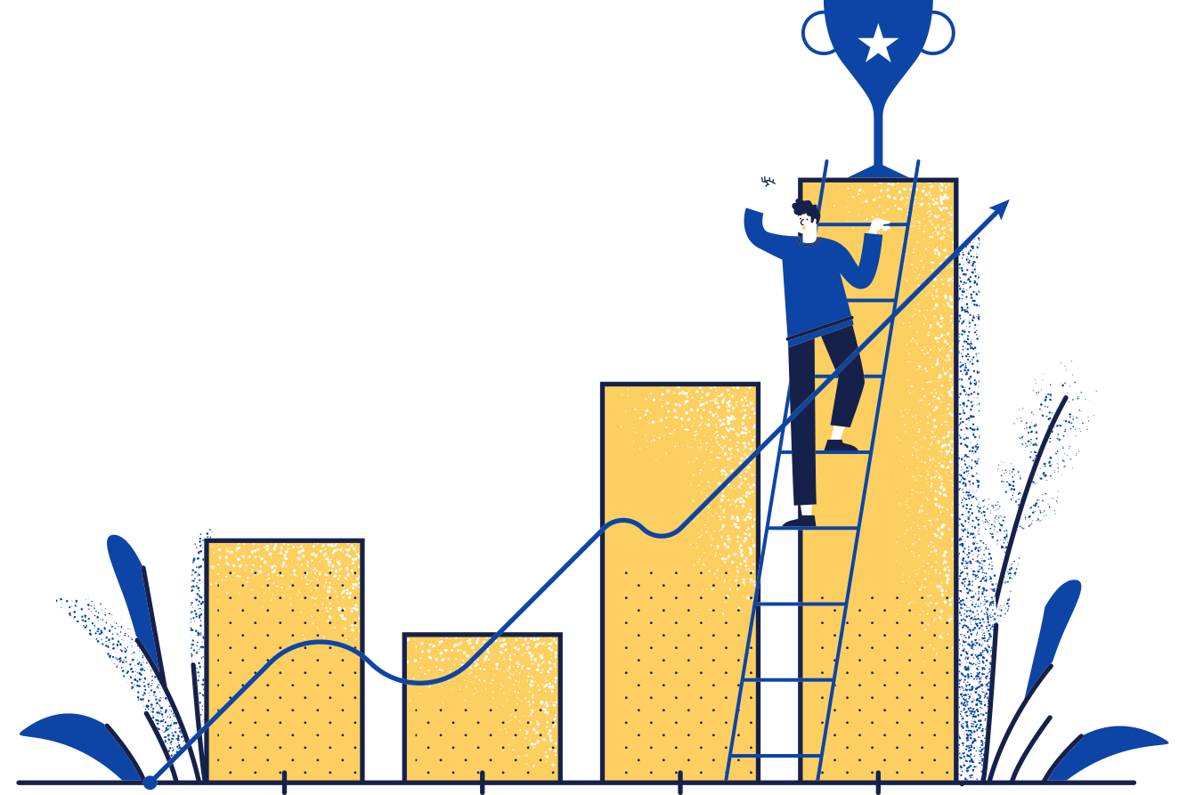
Relationship Building
Some ideas to help foster an open, honest, & anti-racist relationships with your students
KRISTIN L. KRUEGER, PHD (ANTHROPOLOGY)
AANA MARIE VIGEN, PHD (THEOLOGY)

Slide 16
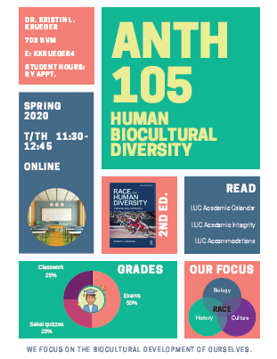
Invite your students in with your syllabus design. (CANVA)
Add in a "syllabus treasure“

Slide 17
FULL NAME:
PREFERRED NAME:
PRONOUNS:
YEAR IN SCHOOL (e.g. junior, senior, etc.):
MAJOR/S &/or MINOR/S:
CAREER GOALS:
HOBBIES:
WHAT ARE YOU HOPING TO LEARN IN THIS COURSE?
I WISH MY PROFESSOR KNEW….
GETTING TO KNOW YOU

Slide 18
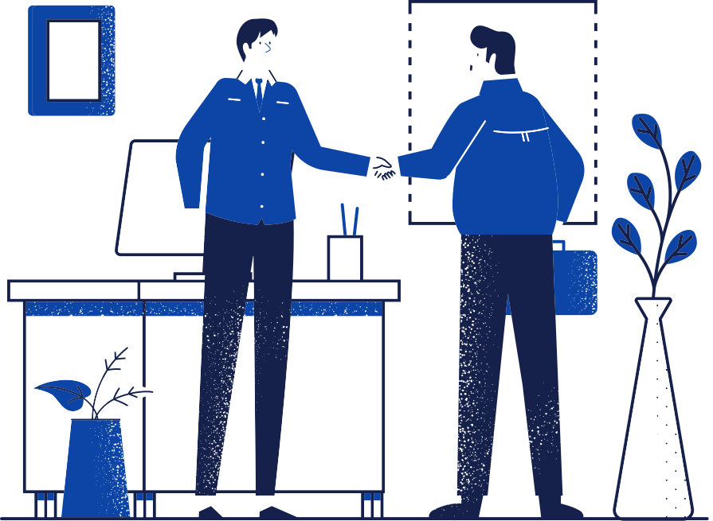
DAY ONE sets the tone for the course.
Be upfront about your goals, intentions, etc.
Be honest about your own whiteness, privilege, social location, etc.
"I AM YOUR COACH, NOT YOUR ADVERSARY."

Slide 19
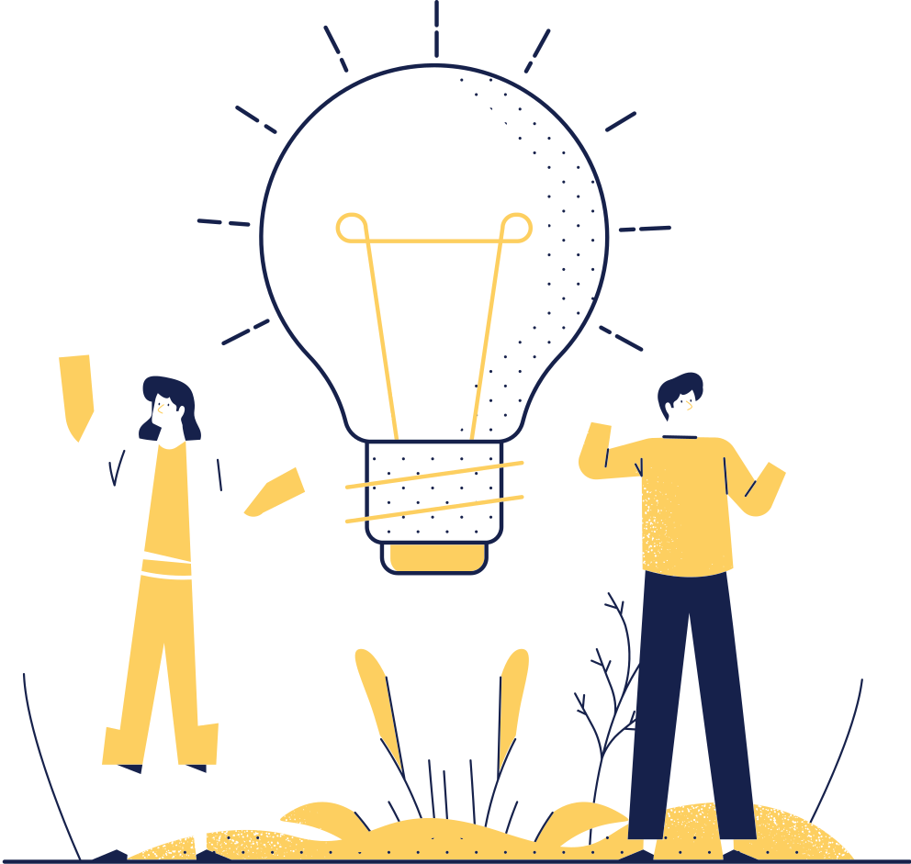
Talk with your students 1:1 before class, if possible!

Slide 20
When students talk, really listen.

Slide 21
Bring Your Whole Self
intellect/knowledge
questions
empathy
authenticity
humor
humility & quiet confidence
(it won't undermine your authority!)

Slide 22
How?
Be Transparent -- share the rationale, decision-making process
Attend to power dynamics
Listen to Understand (rather than win an argument; professors can bully)
Take a Breath (or press pause & come back to it next class; meet individually)
It's Ok to say "I don't know. I'll get back to you" (& then do!)
Ask Permission - to share information/stories, to make changes to the syllabus, etc.
Solicit Input -anony. midterm check ins; let students pick some topics
Take Responsibility; Admit Mistakes ( & learn from them)

Slide 23
Human beings are situated in myriad social relationships & identities. These combinations affect our varied/distinct experiences, attitudes, assumptions, & beliefs (worldviews).
NO REALLY, HOW?!?!
SOCIAL LOCATION RECAP
(& I SHARE SOME OF MINE WITH STUDENTS!)
Individuals are often part of both dominant & subjugated identities/groups. Some identifications can be changed (widened, chosen); others are closer to an intrinsic part of who we are (e.g. genetics, family lottery, where you were born, innate attributes, etc.)
Social location matters regardless of our personal beliefs. Not everyone who is white "believes X", yet systems/structures matter—how white people benefit from them. Beliefs alone have little to do with a person’s access to privilege, power, & to affect the decisions/policies of institutions.

Slide 24
SOCIAL LOCATION EXERCISE IN 4 PARTS
Anonymous Survey +Social, Historical Analysis ( Parts 1&2)
wealth, poverty, health, ed., crime, policing, incarceration, housing, stereotyping/profiling, decision-maker demographics, discriminatory laws, historical context of monuments & architecture, business practices, climate change environmental racism, etc.
What are the deomgraphics in your field?? Who are the "Experts"?
Use Stories & Statistics!

Slide 25
ANONYMOUS SURVEY QUESTION EXAMPLES
THEO 185 - VIGEN
AGREE WITH THE STATEMENT = Y; DISAGREE WITH IT = N
I GREW UP IN A SAFE NEIGHBORHOOD WITH GOOD SCHOOLS.
IT WAS ASSUMED FROM A YOUNG AGE THAT I WOULD GO TO COLLEGE.
I GREW UP IN A HOUSE OWNED BY MY PARENTS.
GROWING UP, I WENT ON REGULAR FAMILY VACATIONS
I HAVE NEVER BEEN HOMELESS.
I DON'T HAVE TO WORRY ABOUT HELPING MY PARENTS FINANCIALLY WHEN THEY RETIRE.
I GENERALLY DON’T WORRY IF THERE WILL BE ENOUGH MONEY TO COVER BASIC EXPENSES
NO ONE IN MY IMMEDIATE FAMILY HAS EVER BEEN ADDICTED TO DRUGS OR ALCOHOL.
I DON’T HAVE TO COPE WITH FREQUENT CATCALLS BECAUSE OF MY GENDER AND/OR SEXUAL IDENTITY
MY PARENTS DO NOT HAVE A NOTED ACCENT.
SCHOOLS I HAVE ATTENDED TEACH ABOUT MY RACE & HERITAGE & PRESENT IT IN POSITIVE WAYS.
I CAN LOOK IN MAINSTREAM MEDIA & SEE WIDE, FAIR REPRESENTATION OF PEOPLE WHO LOOK LIKE ME.
I HAVE FRIENDS OF A RACE(S) DIFFERENT THAN MINE & HAVE BEEN TO THEIR HOME SEVERAL TIMES, HAD SLEEPOVERS AS KIDS, ETC.
NEARLY ALL OF MY GOOD/CLOSE FRIENDS & I SHARE THE SAME RACIAL-ETHNIC IDENTITY
I SPEND MOST OF MY FREE TIME WITH PEOPLE FROM A SIMILAR RACIAL-ETHNIC & SOCIO-ECONOMIC BACKGROUND AS MINE
I CAN BE PRETTY SURE THAT IF I GO INTO A BUSINESS & ASK TO SPEAK TO THE "PERSON IN CHARGE" THAT I WILL BE FACING A PERSON OF MY RACE
I NEVER THINK TWICE ABOUT CALLING THE POLICE WHEN TROUBLE OCCURS.
I HAVE NEVER FELT STEREOTYPED BY A PERSON IN RELATIVE AUTHORITY OVER ME

Slide 26
Part 3
Social Location In-Class Discussion Exercise:
In Small & Then Large Group, Map:
(credit to Dr. Jennifer Harvey, Drake University
author, Raising White Kids)
Institutions Decision-Makers Identifiers

Slide 27
Part 4: CONVERSATIONS ACROSS DIFFERENCE
On Healthcare:
Interview someone who is different from you in at least 4 different aspects of social location about that person's experience
with healthcare.
On Social/Political Issues:
Have a conversation on a topic you both care about, but have different views & come at it from
different social locations.
Click here for the Robb Willer TED talk.

Slide 28
What do you to build relationships with your students? What are your biggest struggles?
Chat Question

Slide 29
Student-Student Relationships & Interactions
Betsy Jones Hemenway, History, Women's Studies & Gender Studies
Sasha Adkins, Institute of Environmental Sustainability
Notes:
Betsy will start here

Slide 30
Starting points
“…our work is not merely to share information but to share in the intellectual and spiritual growth of our students. To teach in a manner that respects and cares for the souls of our students is essential if we are to provide the necessary conditions where learning can most deeply and intimately begin.”
bell hooks, Teaching to Transgress: Education as the Practice of Freedom. Routledge, 1994, 13.
Notes:
[Betsy's slide] -- section 3 – student-to-student relationships / creating community

Slide 31
How do we create conditions where learning can begin?
Some possible Day 1 activities:
Students pair up and do 2-minute interviews of one another with set questions. Then they introduce one another to the rest of the class.
In WSGS, I begin with asking about hopes and dreams for our time together. What do students want that experience to be like? Then we collectively come up with specific guidelines (laptop use, raising hands, taking breaks, etc.). Then I type them up the list and distribute at the next class. We all sign each copy, so each person has the document.
I have a simple "syllabus agreement" where students can confidentially share their preferred name and pronouns, as well as any ongoing issues they might be facing that could affect their work in the class.
Notes:
[Betsy's slide] section 3- student-to-student relationships / community
How to create a community of learners?
These are not discipline specific, although some might be more effective with smaller or larger groups.
I explicitly state in my syllabus and during the first class that, while I have more experience than most of them, I am not the only person in the room with knowledge – and often they know things that I don't. My role, then, is to facilitate their learning however I can.

Slide 32
How do we create the conditions for learning?
After Day 1:
Keep students talking to/with one another
Small group activities in class (summarize a short reading with a Tweet)
Online discussion forums
Student moderators of class discussions
Encourage them to learn one another's names
De-center my own presence by not sitting at the front of the room (at the side of the table in a seminar space, or at the back of the room during student presentations)
Notes:
[Betsy's slide] -- section 3—student-to-student relationships / community
These are just some of my current practices. I'm sure there are other things that people do that are equally effective.

Slide 33
Keeping Stack ​
Notes:
(Sasha's slide) One of the things that makes me so nervous in this format is that it feels unnatural to have to plan exactly what I'm going to say ahead of time and not let myself be responsive to what I'm learning from those who speak ahead of me. But one of advantages is that I know I will have a turn to speak, so I don't need to hold my hand in the air and worry about whether or not I'll be able to contribute. So in the classroom, to have the best of both worlds, I use a technique that I learned in Quaker meeting, though it is probably used elsewhere as well, called “keeping stack.” It's just like taking a ticket at the deli counter and waiting for your number to be called. So the facilitator points to each person who raised their hand and gives them a number, going from one side of the room to the other, and they speak in that order. No one can put their hand up again until we've finished going through that stack. If a new person has a thought and raises their hand you just make eye contact with them and let them know you've seen them, and you've added them to the mental stack so if you have 10 people in line, they know they are going to be #11. If you get to someone and they no longer need their turn, they can say, “the point I was going to make has been made,” and we move on. Sometimes we get these wonderful moments where students say, “Well, I was planning to advocate for this position, but after listening to Zhenyu and Gabriela now I think ...”
I find that once everyone gets used to this format, the students generally remember who is ahead of them so once you've assigned a number, you can step back and let them continue their conversation.

Slide 34
Come to class prepared to contribute constructively to activities and discussions. Listening well is just as important as speaking well. You will lose points for monopolizing the discussion, for interrupting, for disrespectful body language, or for using jargon or acronyms without explaining them. You will gain points for asking good questions of me and of your peers, for helping to develop or draw out your classmates’ ideas, as well as for your original insights. We’ll be discussing “hot topics.” A Sufi proverb invites us to consider asking ourselves these questions before speaking: Is it true? Is it kind? Is it necessary? I don’t want anyone to ever feel put on the spot. If I call on you and you have nothing to say, just say “pass” and we’ll move on. You don’t lose points for that. Introverts are welcome to email me their reflections instead of speaking them aloud in class. That earns equivalent class participation points.
Notes:
(Sasha's slide)
From my syllabus...

Slide 35
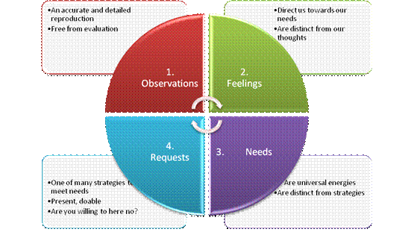
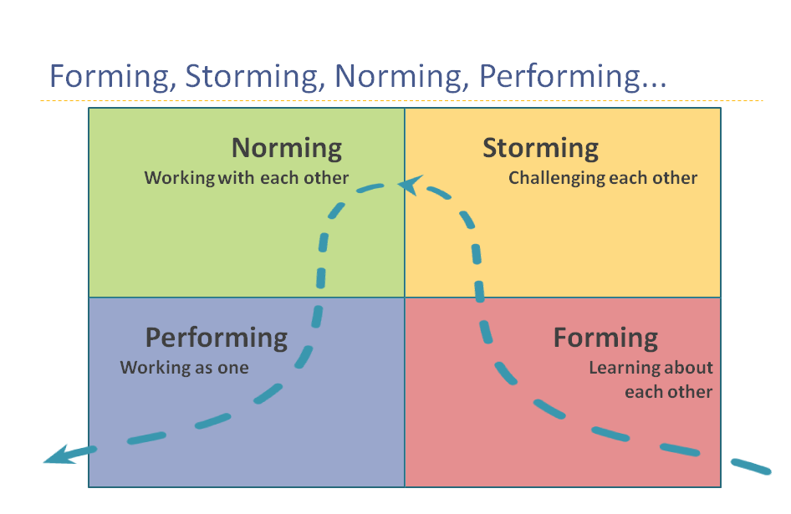
small group work:
providing tools for success
Notes:
(Sasha's slide)
Why I put students in semester-long groups, students chose their groupmates, research shows that it can be helpful for marginalized students to have a group of peers for safety. Groups are wonderful, for the most part, but...
Set up the "bully" scenario, provided safety for the targeted student by inviting her to move to another group in another section, offering resources, checking in, meeting with everyone in the group and offering the opportunity to talk about their behavior (bully or bystander) in a non-judgemental way:
Inviting group work to be a learning tool for everyone, offering the "forming, storming, norming, performing" model, NVC feelings & needs, and the roles in groups frameworks and asking students what I can do to support them in increasing their tolerance for conflict, learning to express their needs, and trying out new roles.
https://web.stanford.edu/group/resed/resed/staffresources/RM/training/grouproles.html

Slide 36
How do you help build relationships among your students? For folks teaching online, how will you be adapting those practices?
Chat question

Slide 37
Student-to-Content
Some elements to foster an anti-racist classroom
Betsy Jones Hemenway, PhD
Aana Vigen, PhD
Kristin Krueger, PhD

Slide 38
STATUS QUO STORIES
“…status-quo stories describe world-views, belief systems, and actions (ontologies, epistemologies, and ethics) that normalize and naturalize the existing social system, values, and standards so entirely that they stunt our imaginations and shape our lives.”
AnaLouise Keating, Transformation Now! Toward a Post-Oppositional Politics of Change. University of Illinois Press, 2013, 169.
How do we re-read or examine these status-quo stories to begin to shift them and our worldviews – and expand our imaginations?
What implications might this practice have for course design and facilitation?

Slide 39
STATUS QUO STORIES
[DECENTERING THE NARRATIVE OF GLOBAL HISTORY]
Global history – shift students’ expectations of the “standard narrative” by incorporating family history into the curriculum.
Examine casta paintings of colonial Latin America to illustrate multiple dimensions of colonial rule, such as social and political hierarchies, mixed populations, economic consequences, and so on.
Compare early modern marriage practices in Western Europe and China to examine theories about how these are linked to economic development and industrialization.
Notes:
A sneaky way of talking about gender, which some students resist if it's too explicit.
They begin to see some of the interconnections, & the fact that the modern nuclear family is not the norm historically or globally.

Slide 40
STATUS QUO STORIES
[DECENTERING THE HISTORY OF FEMINIST THOUGHT]
Invert the order in which material is presented to foreground marginalized voices.
Begin with Indigenous, Black, multicultural, and postcolonial feminisms, rather than the standard 18th and 19th century thinkers (who come in later in the semester).
Pairs of students present on each topic and are required to examine the historical roots and specific thinkers in each tradition, so shape the narrative of our learning.
Notes:
Begin with marginalized voices (Indigenous feminism, Black feminism, multicultural feminism, etc.), rather than the usual linear narrative
from the 18th - 20th century, where the other voices are kind of tagged on at the end.
Helped us see the real variety of feminisms all through its history.

Slide 41
FISHBOWLS
Goal: Empathy/Appreciation
4-5 small groups of students, each represents a different author, experience, story.
(Or share their own experiences)
In the fishbowl, 2 (or 1) people at a time
represent each author/perspective. The others observe. They tap in. All take a turn.
Represent the view of the author/view as fairly & as accurately as possible.
[Or share their own experience]
https://sites.google.com/site/maryellendakinsclassroom/speaking-and-listening/fishbowl-discussions

Slide 42
TOWN HALLS -
Discuss the implications of the law, policy, science, history, story, research, case…
Aim: Develop Critical Thinking & Empathy
Assign students to a side different than their own view/experience. (can do more than 2 perspectives). 1st they role play that view & later may speak as themselves
Know Your Students Well
Assign Crisp, Credible, Thought-Provoking Articles on a Debatable Topic

Slide 43
Center marginalized voices!

Slide 44
Who writes your required texts?
Who writes your assigned readings?
Who is part of the "canon" in your discipline?
What images do you use in your lectures?
What videos do you watch?
What podcasts do you assign?

Slide 45
This requires extra work & effort, but it's worth it for a more comprehensive experience for your students.

Slide 46
Who is one marginalized scholar/ practitioner you can highlight in your course?
Chat question

